Slide 1
Clean Code, Software Design, and Refactoring
Dr. Jason B. Shepherd
https://pixabay.com/photos/london-underground-city-subway-2742625/

Slide 2
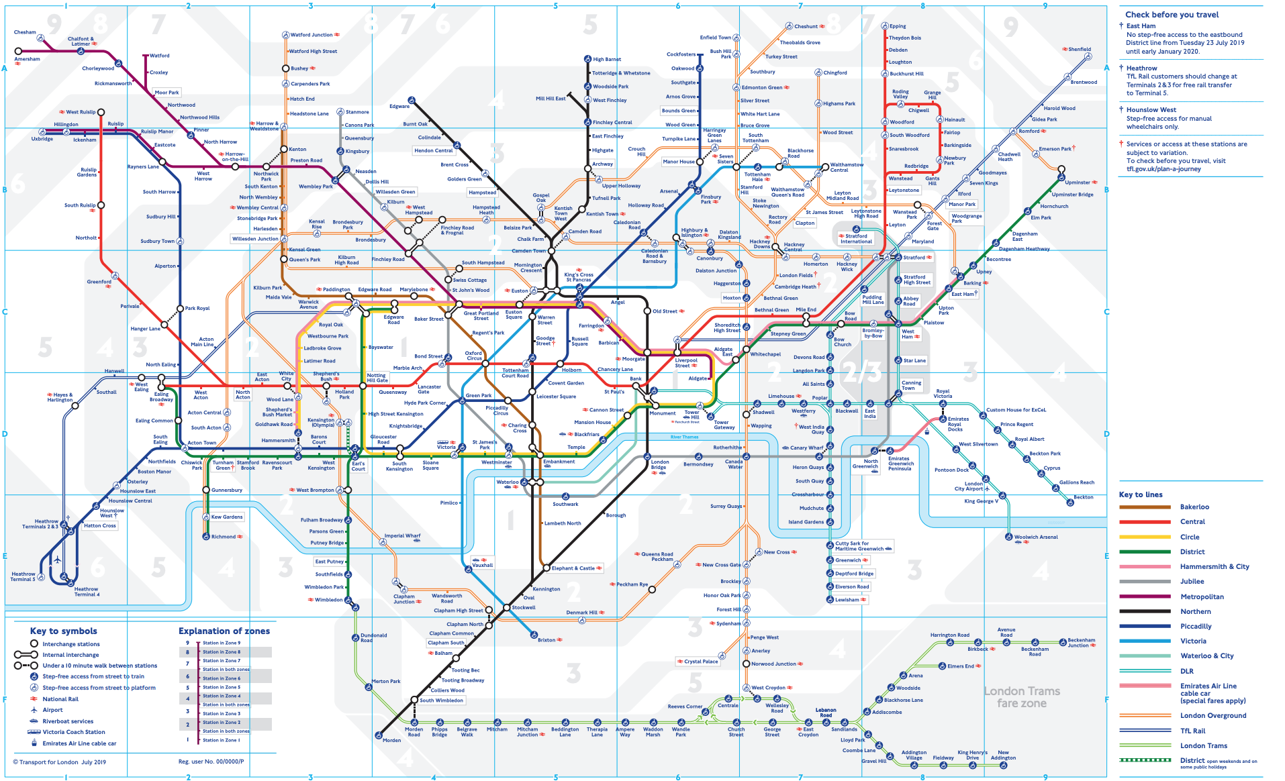

Slide 3
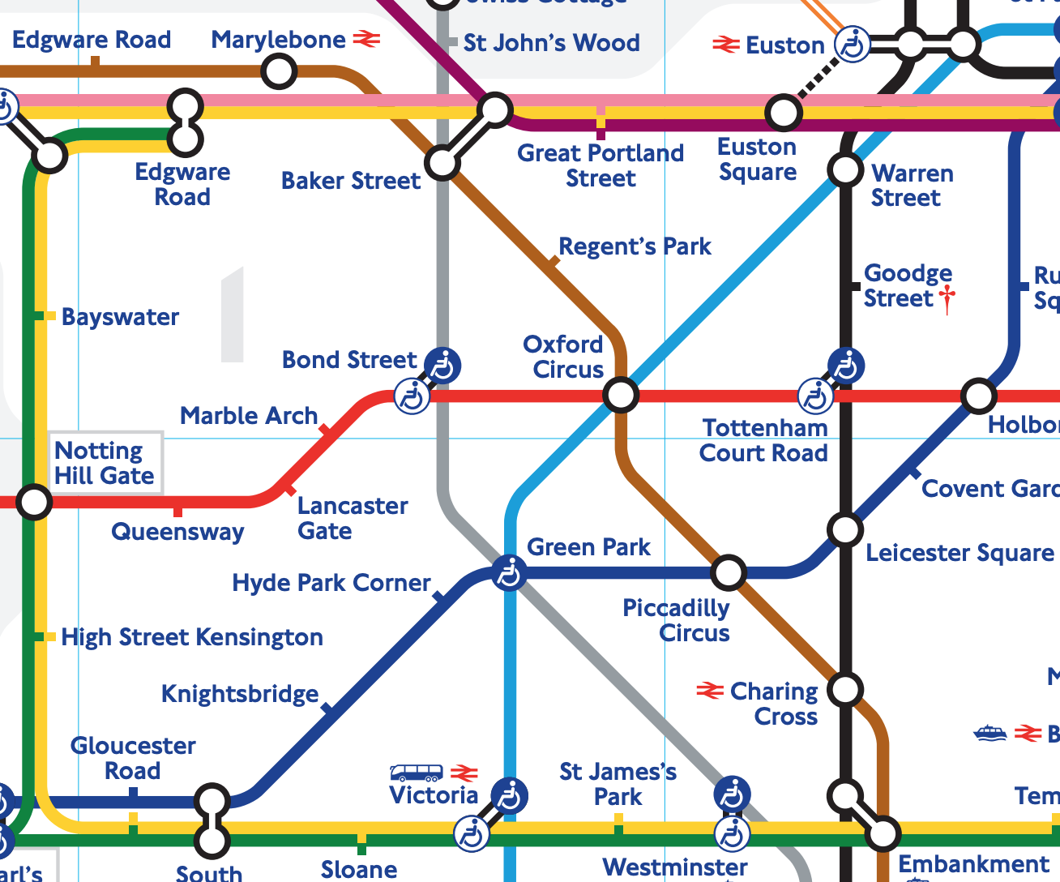
Observations:
Considerable complexity
Modularity
Routes
Transfer Stations
Redundancy
Has likely changed much over decades
Expandable
Map is readable
Map organization is conceptual rather than truly geographic

Slide 4
Overview
The role of code in software development
Coding conventions
OO in Python
“Shaping” code through design (design principles)

Slide 5
Requirements <--> Design <--> Code
Code is the “details of the requirements”
Requirements come from customers
Requirements are shaped by us through personas and user stories
Code is shaped through design
Designs evolve
Code must be refactored

Slide 6
The Total Cost of Owning a Mess
Release cycles stretch
Bugs not fixed in most recent release
Load times grow
Crashes
Product rushed to market

Slide 7
The Total Cost of Owning a Mess
No change is trivial anymore
Inevitable: the grand redesign by the “tiger team”
A short, interesting read: https://www.jwz.org/gruntle/nomo.html
A longer, interesting read: Clean Code by Robert C. Martin

Slide 8
Overview
The role of code in software development
Coding conventions
OO in Python
“Shaping” code through design (design principles)

Slide 9
Initial Remarks
Code is read much more than it is written
Variables should always be named the same way
Same with classes, functions, and files
Favor readable code over comments/documentation
… but comment/document where needed!
Eschew the use of black magic! (especially w/o comments)

Slide 10
Which is Better?
def make_user(*args):
f, l, classname = args
return eval(classname)(f, l)
def make_user(first, last, type_):
if type_ == 'Student':
return Student(first, last)
elif type_ == 'Faculty':
return Faculty(first, last)
else:
raise Exception('Unknown type "{}”’.format(type_))

Slide 11
PEP8 – A Style Guide for
Refer to class repo Reading Assignment Links → Coding Conventions.
I will not read this to you. You are responsible for reading PEP8.
Main ideas:
Naming conventions for variables, functions, class, and modules
Docstrings
Whitespace and indentation
Let a tool do the work.
pycodestyle
pip install pycodestyle (from with a virtual environment)
pycodestyle myfile.py
Vim (~/.vimrc)
set textwidth=79

Slide 12
Overview
The role of code in software development
Coding conventions
OO in Python
“Shaping” code through design (design principles)

Slide 13
First, Interactive Python
dir() and dir(☐) and help(☐)
☐.__doc__
def ☐():
''' This is what this function does.
For now all it does it pass.
'''
pass

Slide 14
A tour of OO Python, with turtles…
Classes
What’s really going on?
magic methods/dunders
Subclasses
Modules, __all__, sys.path, and PYTHONPATH
We’ll save Packages for later in the course when we talk about unit testing.

Slide 15
More code quality tips
Functions should only do one thing.
Functions should strive to only accept zero or one parameters.
Function bodies should be small.
Flag parameters are bad.
convert(true)
convert_to_csv()
convert_to_xls()
# What on Earth does this mean?
def convert(is_csv):
# ...

Slide 16
Overview
The role of code in software development
Coding conventions
OO in Python
“Shaping” code through design (design principles)

Slide 17
Design “Shapes” the Code
Extending the turtles example
Put them on a grid
Draw the grid
Let the turtles move
Who keeps track of turtle locations?
Who keeps track of walls?
What happens when turtles collide?
Who detects collisions?

Slide 18
SOLID Design Principles
Single responsibility principle
Open-closed principle
Liskov substitution principle
Interface segregation principle
Dependency inversion principle
Robert C. Martin
Bertrand Meyer
Barbara Liskov
All images are public domain.

Slide 19
Single responsibility principle
Every class should have responsibility over a single part of the functionality provided by the software.
That responsibility should be entirely encapsulated within the class.
All the class’s services should be narrowly aligned with that responsibility.
Related: Tight cohesion
Related: Separation of concerns

Slide 20
Open-closed principle
Software entities (classes, modules, functions, etc.) should be open for extension, but closed for modification.
Modification of classes or modules creates ripple effects into client code.
Therefore, favor the use of inheritance (or other OO design patterns, e.g., the Command pattern) to add new features.
Related: Loose coupling

Slide 21
Liskov substitution principle
If C is a subtype of A, then objects of type A may be replaced with objects of type C
This can be done without altering any of the desirable properties of the program (correctness, task performed, etc.).
Favor operations on generic types (“A”) when possible.

Slide 22
Interface segregation principle
No client should be forced to depend on methods it does not use.
Split interfaces that are very large into smaller and more specific ones so that clients will only have to know about the methods that are of interest to them.
Such shrunken interfaces are also called role interfaces.
Java is notorious for violating this.

Slide 23
Dependency inversion principle
High-level modules should not depend on low-level modules. Both should depend on abstractions (e.g. interfaces).
Abstractions should not depend on details. Details (concrete implementations) should depend on abstractions.
https://en.wikipedia.org/wiki/Dependency_inversion_principle

Slide 24
Dependency Injection (a form of DIP)
https://en.wikipedia.org/wiki/File:W3sDesign_Dependency_Injection_Design_Pattern_UML.jpg

Slide 25
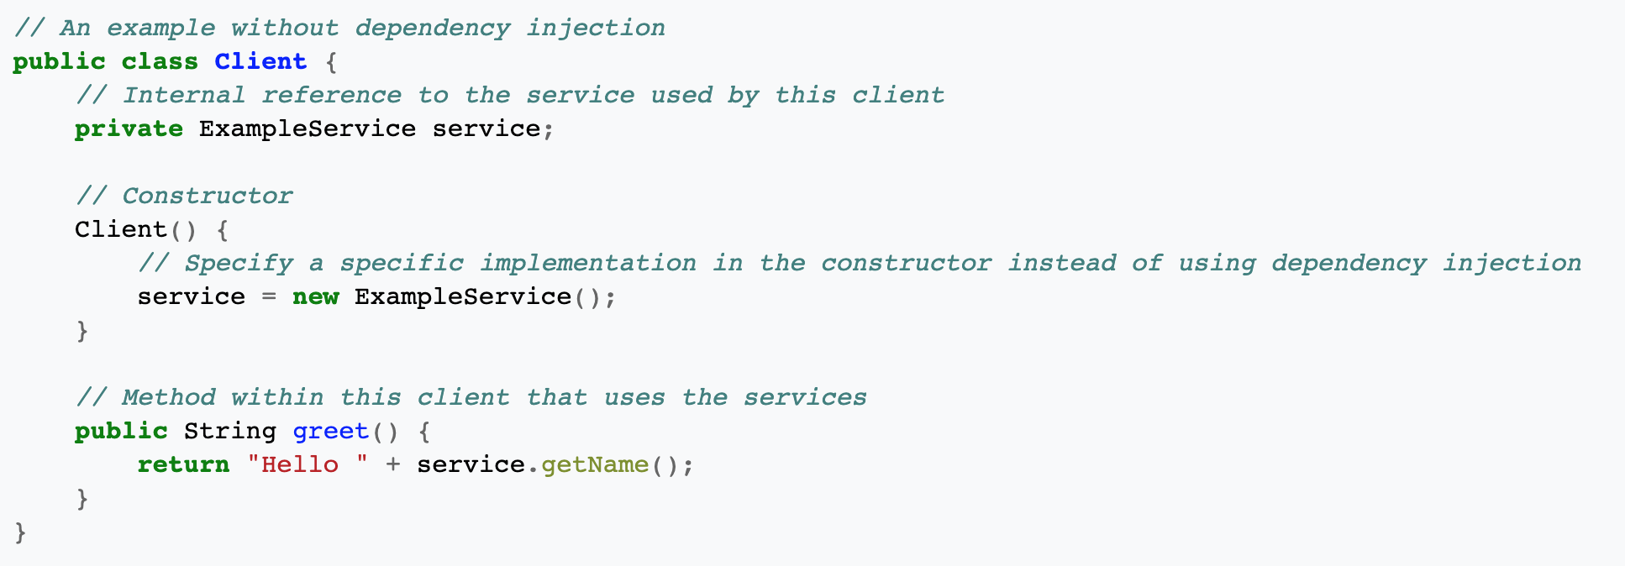
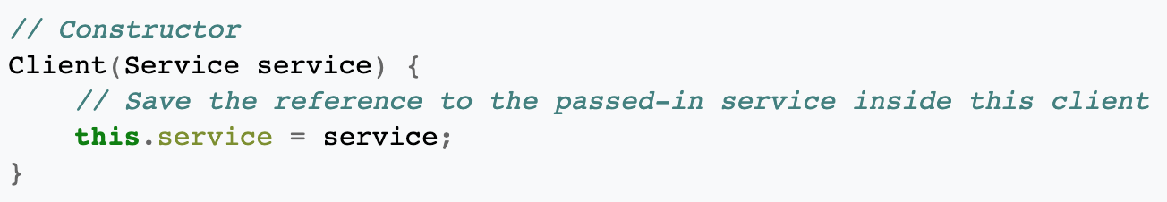
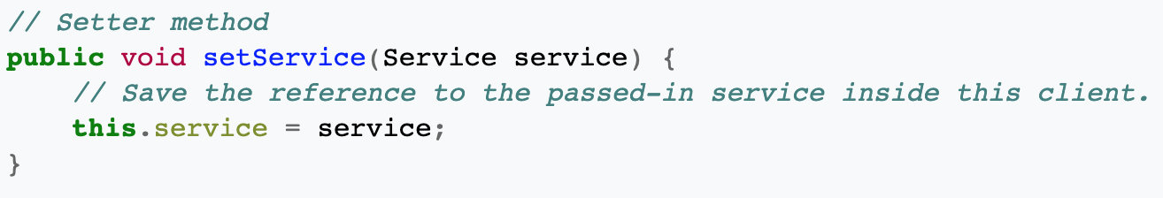
Without dependency injection
With dependency injection
This is difficult to demonstrate in Python since Python is not statically typed.
What happens if setService() is never called before the service is actually needed in a later method?
https://en.wikipedia.org/wiki/Dependency_injection

Slide 26
def calculate_pay(employee):
if employee.type == Employee.COMMISSIONED:
return calculate_commissioned_pay(employee)
elif employee.type == Employee.HOURLY:
return calculate_hourly_pay(employee)
elif employee.type == Employee.SALARIED:
return calculate_salaried_pay(employee)
else:
raise InvalidEmployeeTypeException
Example inspired by Clean Code by Robert C. Martin

Slide 27
def calculate_pay(employee):
if employee.type == Employee.COMMISSIONED:
return calculate_commissioned_pay(employee)
elif employee.type == Employee.HOURLY:
return calculate_hourly_pay(employee)
elif employee.type == Employee.SALARIED:
return calculate_salaried_pay(employee)
else:
raise InvalidEmployeeTypeException
What SOLID principles are being violated in this earlier example?
Example inspired by Clean Code by Robert C. Martin

Slide 28
def calculate_pay(employee):
if employee.type == Employee.COMMISSIONED:
return calculate_commissioned_pay(employee)
elif employee.type == Employee.HOURLY:
return calculate_hourly_pay(employee)
elif employee.type == Employee.SALARIED:
return calculate_salaried_pay(employee)
else:
raise InvalidEmployeeTypeException
What SOLID principles are being violated in this earlier example?
SRP: more than one reason for it to change
Example inspired by Clean Code by Robert C. Martin

Slide 29
def calculate_pay(employee):
if employee.type == Employee.COMMISSIONED:
return calculate_commissioned_pay(employee)
elif employee.type == Employee.HOURLY:
return calculate_hourly_pay(employee)
elif employee.type == Employee.SALARIED:
return calculate_salaried_pay(employee)
else:
raise InvalidEmployeeTypeException
What SOLID principles are being violated in this earlier example?
SRP: more than one reason for it to change
OCP: it must change when new types are added
Example inspired by Clean Code by Robert C. Martin

Slide 30
def calculate_pay(employee):
if employee.type == Employee.COMMISSIONED:
return calculate_commissioned_pay(employee)
elif employee.type == Employee.HOURLY:
return calculate_hourly_pay(employee)
elif employee.type == Employee.SALARIED:
return calculate_salaried_pay(employee)
else:
raise InvalidEmployeeTypeException
What SOLID principles are being violated in this earlier example?
SRP: more than one reason for it to change
OCP: it must change when new types are added
Also, many other functions are likely to have the same structure:
ispayday(employee, date)
pay(employee, money)
Example inspired by Clean Code by Robert C. Martin

Slide 31
def calculate_pay(employee):
if employee.type == Employee.COMMISSIONED:
return calculate_commissioned_pay(employee)
elif employee.type == Employee.HOURLY:
return calculate_hourly_pay(employee)
elif employee.type == Employee.SALARIED:
return calculate_salaried_pay(employee)
else:
raise InvalidEmployeeTypeException
class Employee: # abstract
def is_payday(): pass
def calculate_pay(): pass
class EmployeeFactoryImpl(EmployeeFactory):
def make_employee(rec):
if rec.type == COMMISSIONED:
return CommissionedEmployee(rec)
elif rec.type == HOURLY:
return HourlyEmployee(rec)
elif rec.type == SALARIED:
return SalariedEmployee(rec)
class EmployeeFactory: # abstract
def make_employee(record): pass
Example inspired by Clean Code by Robert C. Martin

Slide 32
Design by Contract
Whose responsibility is it to ensure preconditions are met?
Whose responsibility is it to ensure postconditions are met?
https://en.wikipedia.org/wiki/Design_by_contract#/media/File:Design_by_contract.svg

Slide 33
Use of exceptions
def total_deposits(acct_num):
deposits = []
total = 0.0
try:
deposits = service.get_deposits(acct_num)
for deposit in deposits:
total += deposit
except BadAccountException as e:
print(e)
return total

Slide 34
Use of exceptions
def total_deposits(acct_num):
deposits = []
total = 0.0
try:
deposits = service.get_deposits(acct_num)
for deposit in deposits:
total += deposit
except BadAccountException as e:
print(e)
return total
This shows the error but doesn’t do anything about it.
It also returns a bogus value!

Slide 35
Use of exceptions
def total_deposits(acct_num):
deposits = service.get_deposits(acct_num)
for deposit in deposits:
total += deposit
return total
The caller is responsible for catching the exception using an ‘except’ block.

Slide 36
Use of exceptions
def total_deposits(acct_num):
deposits = service.get_deposits(acct_num)
for deposit in deposits:
total += deposit
return total
# Caller
try:
acct_num = input('Enter account #: ')
total = total_deposits()
except BadAccountException as e:
print('%s is not a valid account number.' % acct_num)
The caller is responsible for catching the exception using an ‘except’ block.

Slide 37
Design Contracts in Python
Using abstract classes…
from abc import ABC, abstractmethod
class AbstractFortuneService(ABC):
@abstractmethod
def get_fortune(self):
pass
class RickRollFortuneService(AbstractFortuneService):
def get_fortune(self):
return 'Never gonna give you up, ...'
a = AbstractFortuneService() # TypeError: Can't instantiate ...
rr = RickRollFortuneService()
rrf = rr.get_fortune()

Slide 38
Exercise: Critiquing others’ code
Get in groups of two or three from your team.
Look at the code found on two or three well-known GitHub repos.
Find evidence of OO design principles at play.
Or, possibly, their absence!
What else do you notice about the way the code is organized?

Slide 39
A “visual” language for documenting:
How system is used
How system is structured
How system behaves
Allows us to “see” the code at high-level.
Picture is worth 10,000 words.
Better understand how our system needs to interact with users and other systems.
Look for refactoring opportunities, unnecessary dependencies, etc.
https://en.wikipedia.org/wiki/Unified_Modeling_Language#/media/File:UML_logo.svg

Slide 40
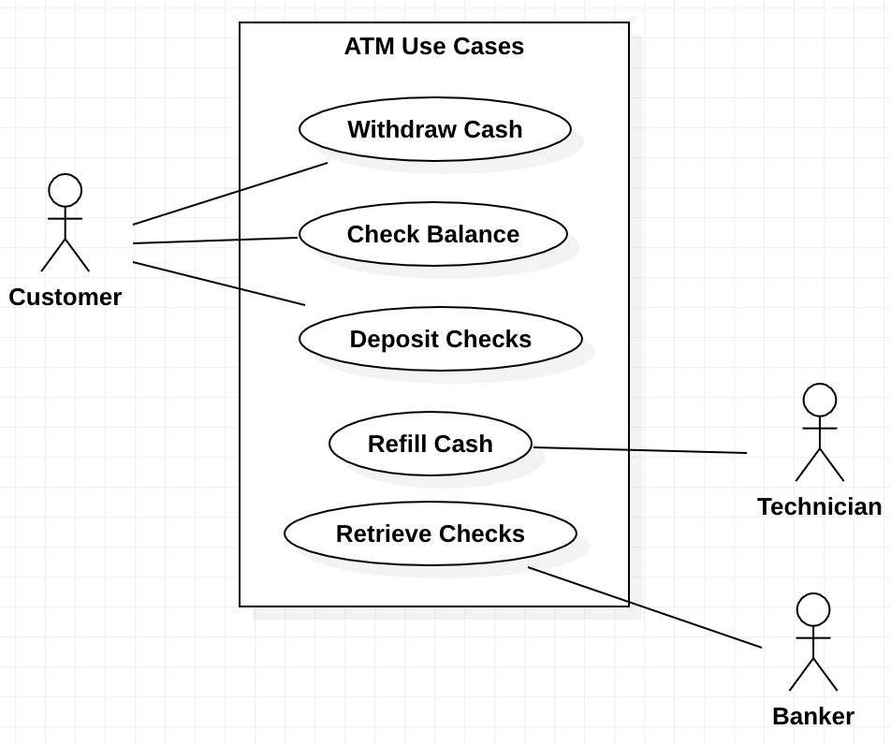
How System is Used
Use Case Diagrams
Actors
Use Cases
Associations
Use Case Subjects
Created using StarUML

Slide 41
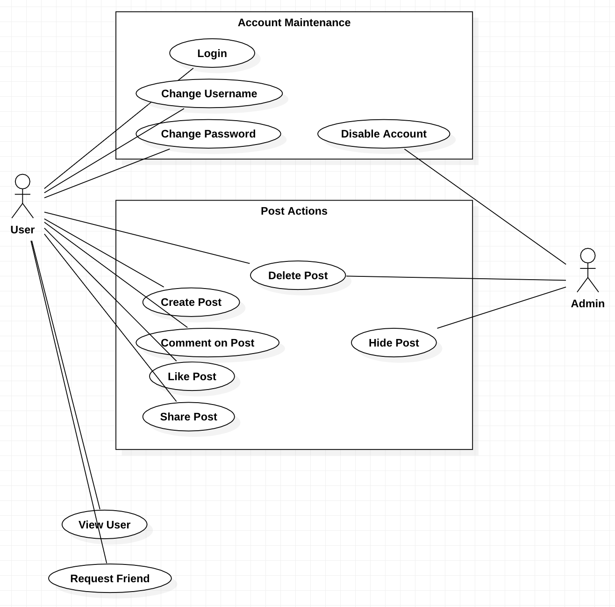
Created using StarUML

Slide 42
How System is Structured: UML Class Diagrams
Example:
User
Name of the class
+userName : String
+email : String
-locked : boolean=false
Variables [optional]
Methods
«constructor» User(u : String, e : String)
+isLocked() : boolean
+toString() : String
Key:
+ means public visibility
# means protected visibility
- means private visibility
<blank> means default (package) visibility
static variables are underlined

Slide 43
Order
Association
-id : int
-userID : String
«constructor» Order(id : int, userID : String)
+getID() : int
+getUserID() : String
+getItems() : List<Item>
+items
1..*
Item
-id : int
-name : String
-description : String
// omitted for brevity

Slide 44
Order
Association
-id : int
-userID : String
«constructor» Order(id : int, userID : String)
+getID() : int
+getUserID() : String
+getItems() : List<Item>
+items
1..*
Item
mutable_list
-id : int
-name : String
-description : String
// omitted for brevity

Slide 45
Order
Association
-id : int
-userID : String
«constructor» Order(id : int, userID : String)
+getID() : int
+getUserID() : String
+getItems() : List<Item>
+items
1..*
Item
mutable_list
-id : int
-name : String
-description : String
This is a note. It’s telling you that mutable_list is a container class for the Items. It is attached to the diagram using a “note connector”.
// omitted for brevity

Slide 46
Actor
Generalization (a.k.a. Inheritance)
-name : String
-description : String
+tell(message : String)
+say(message : String)
Player
NPC
-name : String
-description : String
-socket : Socket
-name : String
-description : String
+tell(message : String)
+tell(message : String)

Slide 47
Reflexive association
Profile
-id: int
-email : String
-firstName : String
-lastName : String
friends : mutable_list
+addFriend(p : Profile)
+removeFriend(p : Profile)

Slide 48
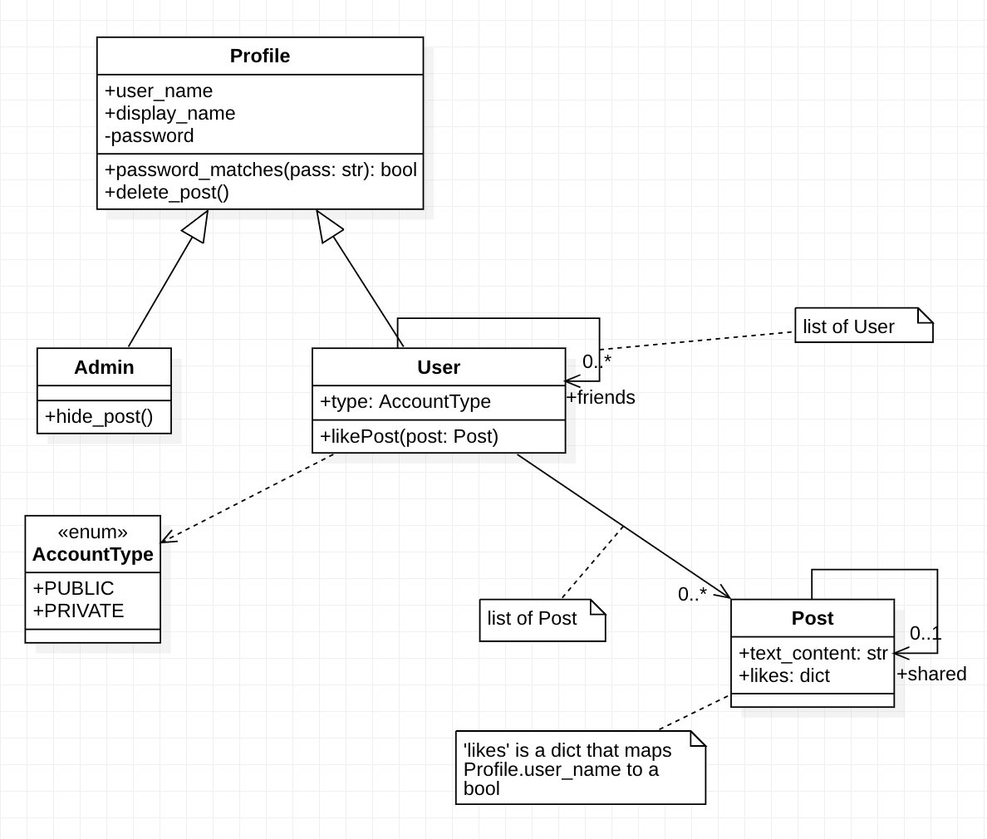
Created using StarUML

Slide 49
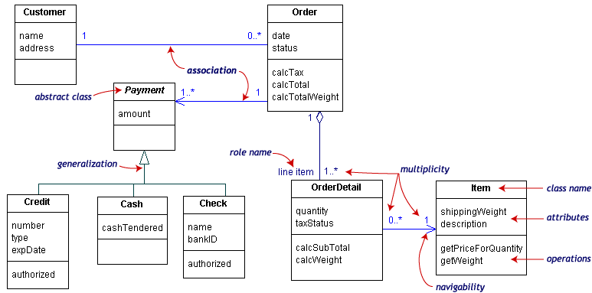
aggregation
Courtesy: Randy Miller

Slide 50
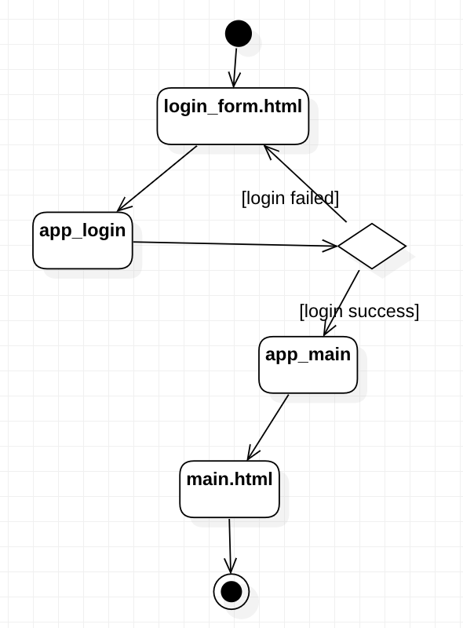
How System Behaves
Created using StarUML

Slide 51
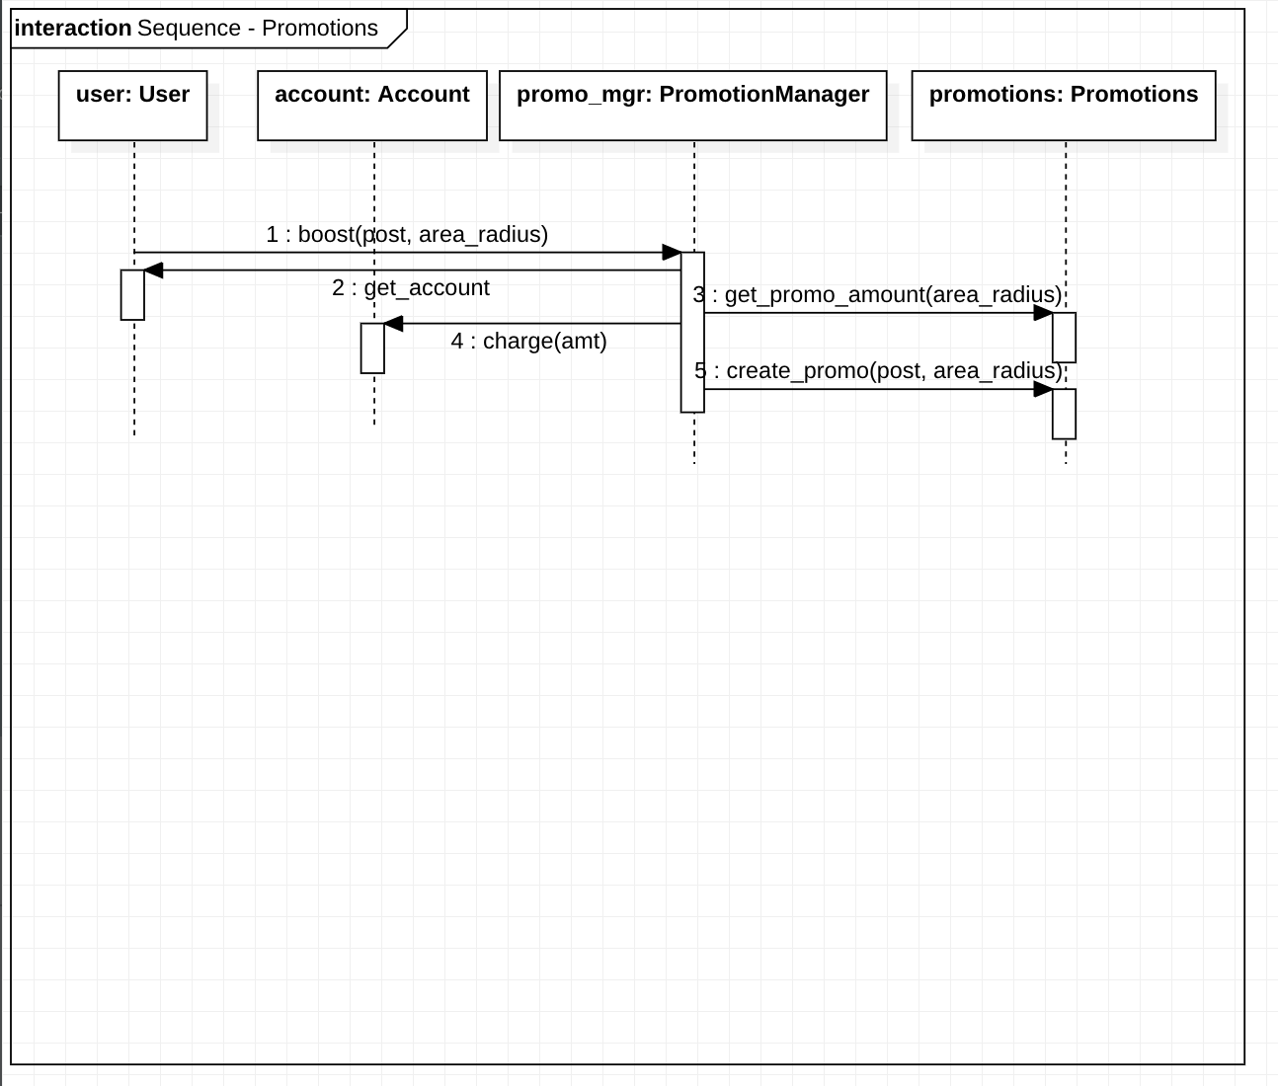
How System Behaves
Created using StarUML

Slide 52
Exercise: Revisit Turtles (if time…)
Who creates the turtles?
Who handles movement of turtles on grid?
What happens when turtles collide?

